Slide 1
Analysis of Diffusion in Social Network
Brought to you by –
Yuhui, Shashvath and Siddhant
Instructor : Assefaw Hadish Gebremedhin
Notes:
Template-Primary on 201

Slide 2
Objectives
Visualize the commnuity detection based on Girvan-Newman algorithm.
Impement a model for the diffusion based on the Page Rank
We anaylze the Diffusion on the different communities

Slide 3
Introduction
Diffusion is a process by which information, viruses, gossips and any other behaviors spread over network in particular social network.
In order to achieve diffusion, PageRank and community detection plays a vital role.
PageRank are proprietary, it is generally believed that the number and importance of inbound links to that page are a significant factor.
One of the most relevant features of graphs representing real systems is community structure, or clustering, i. e. the organization of vertices in clusters, with many edges joining vertices of the same cluster and comparatively few edges joining vertices of different clusters is called as community detection.

Slide 4
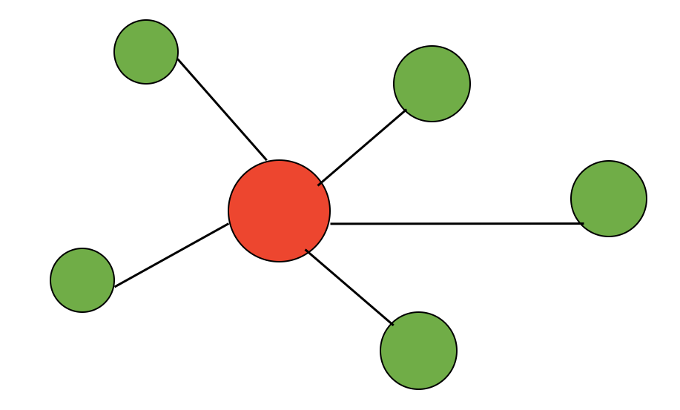


Diffusion
Binomial Distribution:
Poison Distribution:
P
Figure: Simple Network

Slide 5
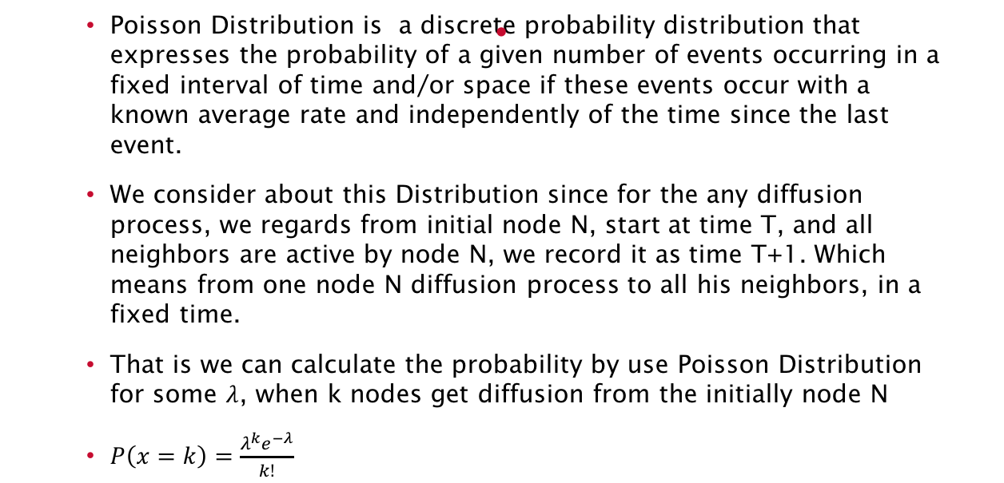
Poisson Distribution

Slide 6
Binomial Distribution
Binomial Distribution with parameters n and p is the discrete probability distribution of the number of successes in a sequence of n independent yes/no experiments, each of which yields success with probability p.
Why we consider about the Binomial Distribution?
When n large enough, p small enough. Binomial Distribution approach to the Poisson distribution.
N in the network means the degree, with the some high degrees, it also can be expressed by using Binomial Distribution. Which means for the different nodes, it can be have same probability to doing the diffusion process.

Slide 7
The Model
We believe it have same probability to spread from the single nodes to their neighbors.
So, for every nodes it has its own probability to process the diffusion.
Then we think if it is same probability is the same to every nodes in the network.

Slide 8


Diffusion in Real-World
Figure: Video share result for popular node
Figure: Video share result for unpopular node

Slide 9
Page Rank
The number and importance of inbound links to that page are a significant factor.
The network considered for this is the Facebook network obtined from snap datasets.
We used R to calculate the page rank properties and get in connection with diffusion

Slide 10
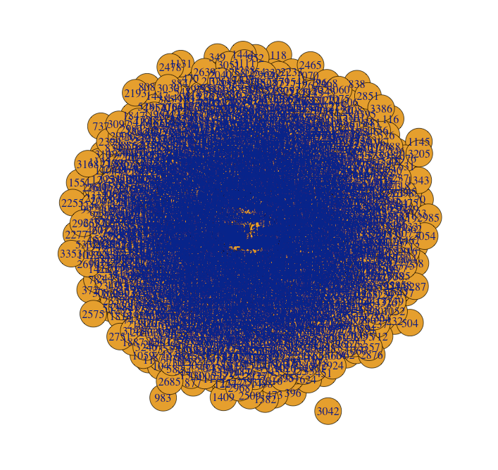
Results
Figure: Graph of the network selected
Network | Page Rank(max value) |  | Max degree |  | Betweenness
 | Max Value | Node | Max Value | Node | Max Value | Node
Facebook | 0.005067841 | 3831 | 214 | 3831 | 60510.5 | 3831
Figure: Results for parameters of page rank

Slide 11
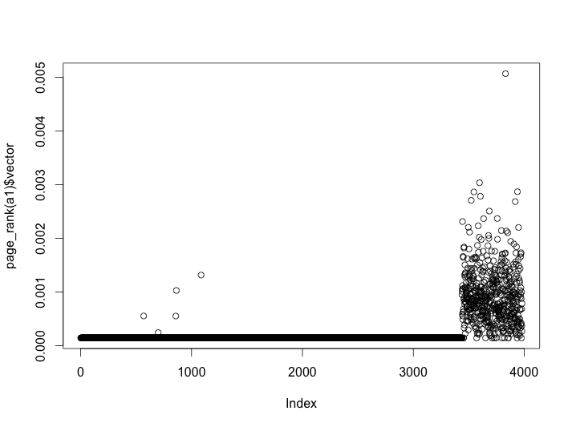
Figure: Plot of PageRank vs index

Slide 12

Continued.…
We assume a standard probability P_{s} for the most important node and the use the priority of the different nodes dividing the highest priority times P_{s} to represent the node for its own diffusion.
Notes:
Ps -> probablity of highest node
P(s) -> priority
P(i) -> priority of ith node/ arbitry node and its id is i
Template-Primary on 201

Slide 13
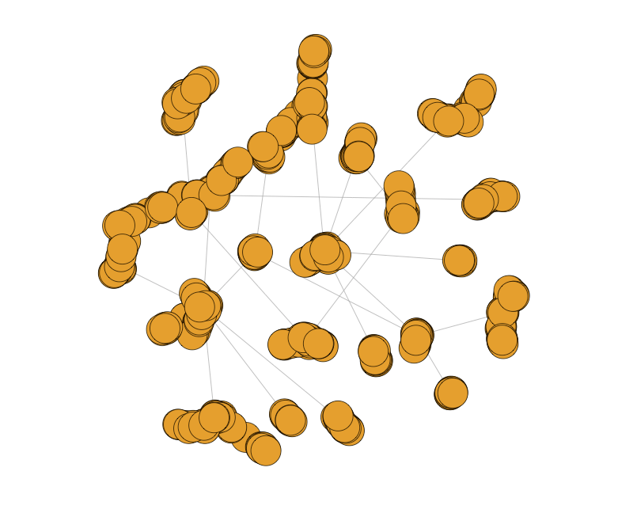
Diffusion from the node with highest probability
Figure: Diffusion result from the highest probability node

Slide 14
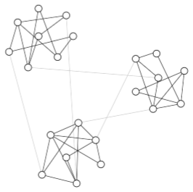
Community Detection
Finding communities in networks is often a common task under the paradigm of complex systems.
Edge betweenness - Number of shortest paths between pairs of vertices that run along it.
More than one shortest path between a pair of vertices, each path is given equal weight such that the total weight of all the paths is unity.
Figure: Community Structure

Slide 15
Network containing communities that are only loosely connected by a few inter-group edges, will have all shortest paths between different communities going along one of these few edges.
Edges connecting communities will have high edge betweenness. By removing these edges, we separate groups from one another and so reveal the underlying community structure of the graph.
Girvan-Newman algorithm is a hierarchal decomposition process where edges are removed in the decreasing order of their edge betweenness scores.
This is motivated by the fact that edges connecting different groups are more likely to be contained in multiple shortest paths simply because in many cases they are the only option to go from one group to another.
Notes:
Template-Primary on 201

Slide 16
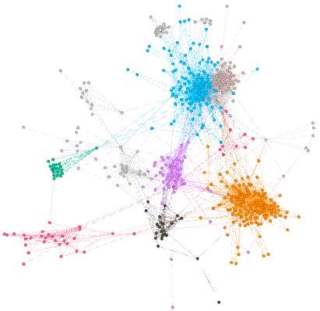
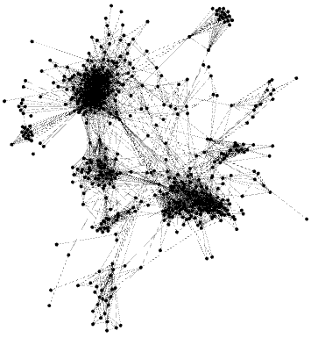
Visualization
Figure: Colored member nodes of communities
Figure: Graphical representation of Nodes
Figure: Colored member nodes of communities

Slide 17
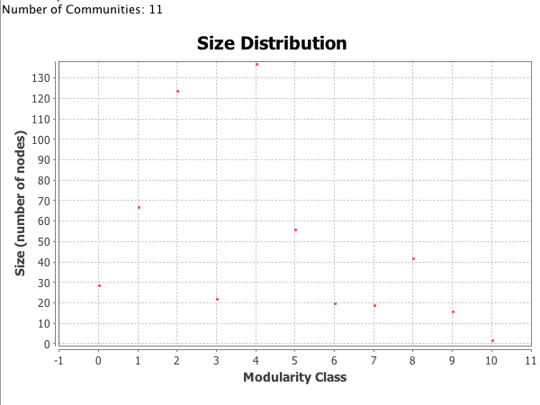
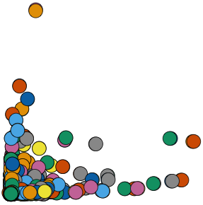
Results
Figure: Colored member nodes
Figure: Size Distribution of the Modularity Class

Slide 18
Results
communities(ebc)$'3447'
communities(ebc)$'3448'
neighbors(g,3503,mode = 'out')
are.connected(g, 3503, 3899)
Nodes 3503 and 3899 are connected but belong to two different communities 3477 and 3448.
Future work –
Diffusion probaility of these two nodes is different in a community and its diffusion would be different with its neighboring node.

Slide 19
Conclusion
We construct a new model for diffusion based on the statistic model.
We have learned that with different importance in network will have different probability for diffusion.

Slide 20
References
Girvan, Michelle, and Mark EJ Newman. "Community structure in social and biological networks." Proceedings of the national academy of sciences 99, no. 12 (2002): 7821-7826.
Granovetter, Mark S. "The strength of weak ties." American journal of sociology (1973): 1360-1380.
David Gleich. “Expanders,Tropical Semi-rings, and Nuclear Norms.”
Daniel M. Romero, Brendan Meeder and Jon Kleinberg. “Differences in the Mechanics of Information Diffusion Across Topics: Idioms, Political Hashtags, and Complex Contagion on Twitter”
David Kempe, Jon Kleinberg and Eva Tardos. “Maximizing the Spread of Influence through a Social Network”

Slide 21


